Slide 1

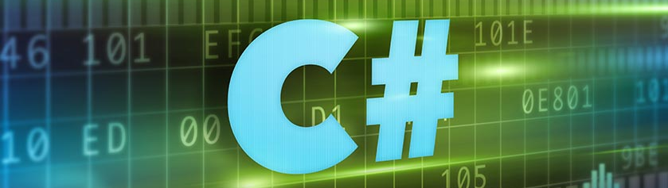
C# Intermediate

Slide 2
What will we learn?
Arrays
Lists
Associative arrays
Foreach loop
LINQ /basics/
Methods
Call by Value
Call by Reference
Out parameter
Text Processing
Objects and classes /basics/
Structures
Enums
Bitwise operators
Regular Expressions
Nullables

Slide 3
What is data structure?
Data structure is a storage (programmatic way) that is used to store and organize data. It is a way of arranging data on a computer so that it can be accessed and updated efficiently.
Data structures are at the core of computer science and they allow programmers to develop algorithms that can be used to solve complex problems

Slide 4

What is an array?
An array is a collection of similar data elements stored at contiguous memory locations. It is the simplest data structure where each data element can be accessed directly by only using its index number. They have fixed size.
elements
Indexes
0
1
2
3
4
5
6
7
8

